Slide 1
Idmc(INFORMATICA DATA MANAGEMENT CLOUD)

Slide 2
ETL stands for Extract, Transform, Load — a fundamental process in data engineering used to move and prepare data for analysis and reporting.
Extract
Data is collected from source systems
Sources can include:
Databases (Oracle, MySQL)
Applications (ERP, CRM)
Files (CSV, JSON, XML)
APIs or cloud services
Goal: Pull raw data without changing it
Transform
Extracted data is cleaned, validated, and converted
Common transformations:
Data type conversions
Removing duplicates
Filtering records
Calculations & aggregations
Standardizing formats (dates, currencies)
goal: Make data accurate, consistent, and usable

Slide 3
Load
Transformed data is loaded into a target system
Targets include:
Data Warehouse
Data Lake
Reporting database
Load types:
Full load
Incremental load
Goal: Make data available for analytics and reporting
What are ETL Tools?
ETL tools are specialized software platforms designed to Extract, Transform, and Load data reliably, at scale, and with governance.
They provide:
Visual, low-code development
Built-in connectors
Metadata & lineage
Error handling and monitoring
Performance optimization
Scheduling & orchestration

Slide 4
Why Not Just Use PL/SQL or Scripts?
    You can use PL/SQL, Python, Shell, etc.
    But they do not scale well for enterprise ETL.
ETL Tools vs PL/SQL / Script
Area | ETL Tools | PL/SQL / Scripts
Development | Drag-and-drop, reusable | Manual coding
Source Support | DBs, files, APIs, SaaS | Mostly DB / limited
Maintainability | Easy to modify | High effort
Error Handling | Built-in retries & logs | Custom code needed
Monitoring | Dashboards & alerts | Manual log checks
Performance | Parallel processing | Mostly serial
Metadata & Lineage | Automatic | Not available
Scheduling | Integrated | Cron / custom jobs
Audit & Compliance | Built-in | Hard to implement
Scalability | Enterprise-grade | Breaks at scale

Slide 5
What is On-Prem ETL?
On-Premises ETL means the ETL tool and infrastructure are installed and managed inside an organization’s own data center.
Key Characteristics
Servers owned by the organization
Installed behind corporate firewall
Managed by internal IT teams
Fixed hardware capacity
Typical Setup
Source systems (ERP, CRM, DB)
On-prem ETL server
On-prem data warehouse
What is Cloud ETL?
Cloud ETL means ETL runs on cloud infrastructure, accessed via browser, with elastic compute and managed services.
Key Characteristics
No local installation
Runs on AWS / Azure / GCP
Auto-scaling compute
Subscription-based pricing
Designed for SaaS, APIs, and cloud data stores

Slide 6
On-Prem ETL vs Cloud ETL
Aspect | On-Prem ETL | Cloud ETL
Infrastructure | Owned & managed | Fully managed
Scalability | Limited by hardware | Elastic, auto-scale
Cost Model | CapEx (servers, licenses) | OpEx (pay-as-you-use)
Deployment | Weeks / months | Hours / days
Upgrades | Manual & risky | Automatic
Accessibility | Internal network | Browser-based
Disaster Recovery | Custom setup | Built-in
Maintenance | High IT effort | Minimal
Cloud Integration | Limited | Native & seamless

Slide 7
What is IDMC? (Informatica Data Management Cloud)
IDMC stands for Informatica Data Management Cloud — a cloud-native, AI-powered data management platform from Informatica.
It helps organizations integrate, govern, secure, and manage data across on-prem, cloud, and hybrid environments.
Why IDMC Was Introduced
Traditional on-prem ETL tools:
  Are hard to scale
  Need heavy infrastructure
  Struggle with cloud & SaaS data
IDMC solves this by being cloud-first, scalable, and AI-driven.
AI at the Core (CLAIRE®)
IDMC uses CLAIRE® AI to:
  Suggest transformations
  Auto-detect data quality rules
  Recommend mappings
  Improve performance & accuracy

Slide 8
Core Services in IDMC
Cloud Data Integration (CDI)
  Cloud ETL / ELT
  Batch & near-real-time pipelines
  Pushdown optimization
Cloud Application Integration (CAI)
  Integrates applications & APIs
  Event-based and real-time flows
Cloud Data Quality (CDQ)
  Profiling, cleansing, validation
  Standardization & matching
Data Governance & Catalog
  Metadata management
  Data lineage & impact analysis
MDM (Master Data Management)
  Single source of truth for key entities
  Customer 360, product 360

Slide 9
IDMC vs Traditional On-Prem Informatica
Aspect | On-Prem Informatica | IDMC
Deployment | Installed in data center | Cloud-native
Scaling | Hardware-limited | Elastic
Upgrades | Manual | Automatic
AI Assistance | Limited | Built-in
Cloud/SaaS | Complex | Native
Cost Model | CapEx | Subscription (OpEx)

Slide 10
IDMC vs Traditional On-Prem Informatica
Aspect | On-Prem Informatica | IDMC
Deployment | Installed in data center | Cloud-native
Scaling | Hardware-limited | Elastic
Upgrades | Manual | Automatic
AI Assistance | Limited | Built-in
Cloud/SaaS | Complex | Native
Cost Model | CapEx | Subscription (OpEx)

Slide 11
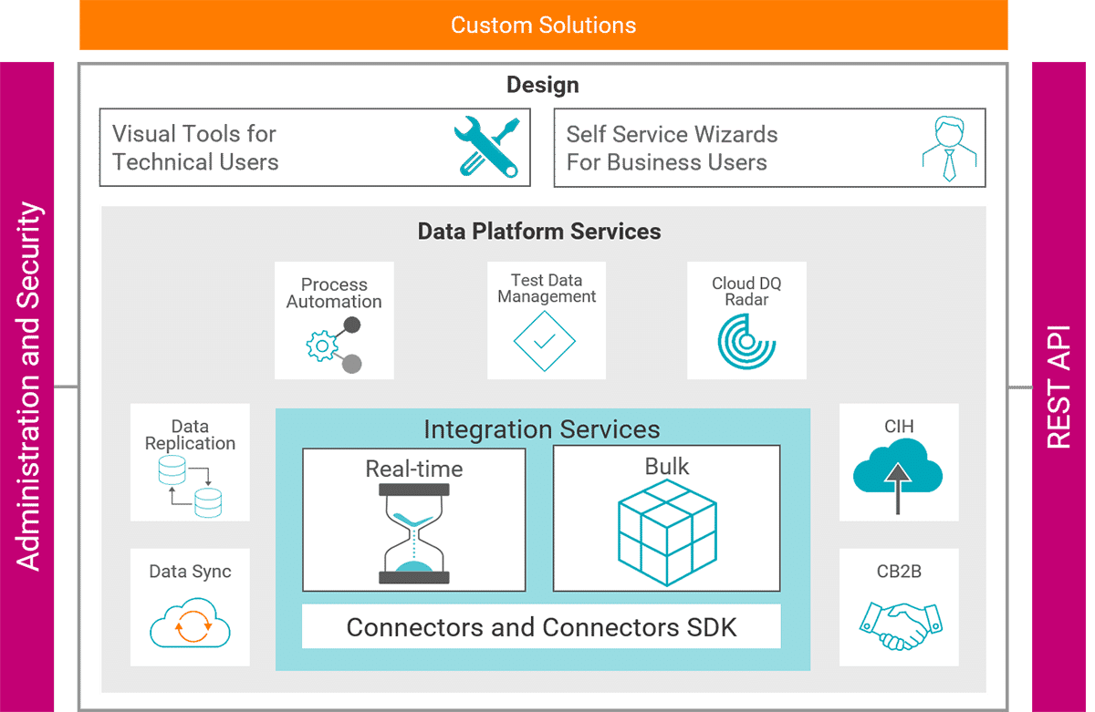

Slide 12
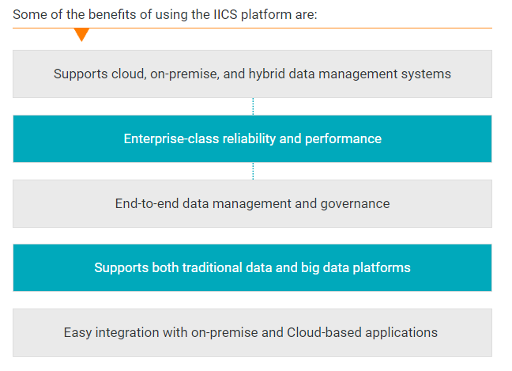

Slide 13
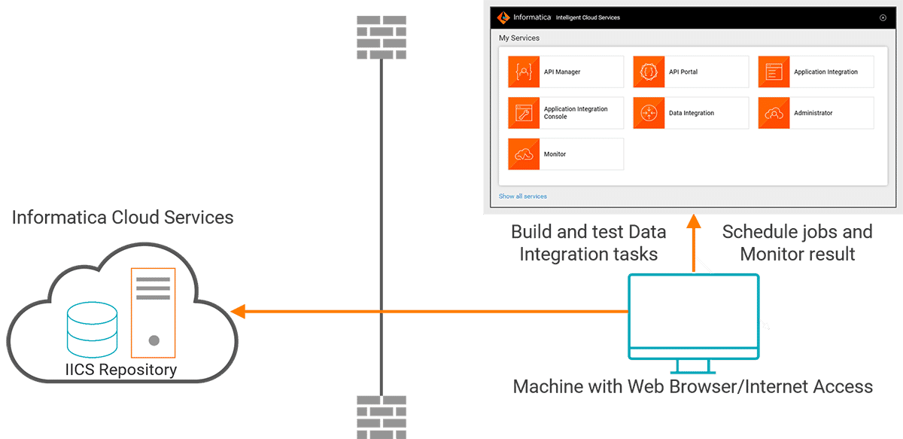
IICS Architecture
Inforamtica Cloud Services
As IICS is an iPaaS based application, you can access it from any machine with Internet access and a web browser

Slide 14
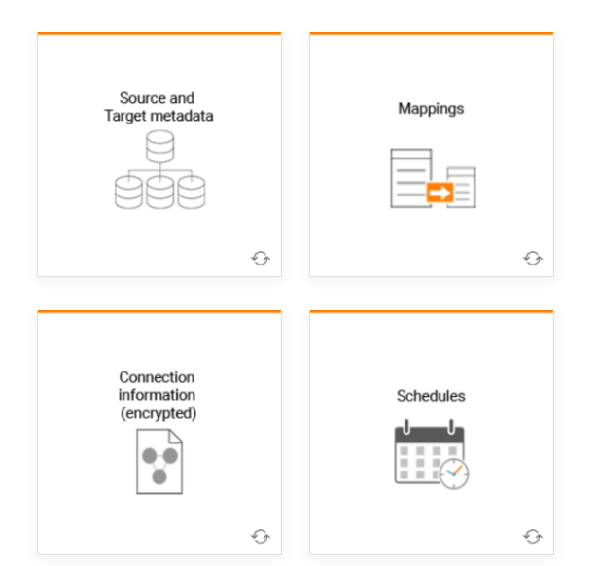
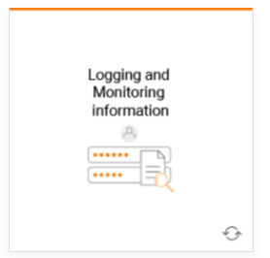
IICS Repository
When you create, schedule, and run tasks, its information is written to the IICS repository.

Slide 15
Cloud Data Integration Service
Data Integration service is used to build high-performing cloud data warehouses and manage data integration activities to use in the IICS tasks.
You can perform the following tasks in the Data Integration service:
Design task from a variety of sources, targets, and transformations and use them to transform and map data.
Execute a task on demand, based on a schedule, or on real time events such as an outbound message triggered in Salesforce
Monitor tasks for session logs, job status, and error logs in the jobs section of the Data Integration Service.
Administer tasks to manage users, their access rights and privileges, and view audit logs.

Slide 16
Mapping : A mapping defines reusable data flow logic that you can use in mapping tasks. A mapping defines the flow of data from a source to a target.
Task Flow : A taskflow controls the sequence in which you execute the tasks. The execution sequence of tasks is based on the execution of the previous task. You must first create tasks and then add them to a taskflow.
Cloud Data Integration Components
Components are assets that support mappings and tasks. You can use a Component within an asset.
A Transformation is a repository object within a mapping that defines rules to read, modify, filter, aggregate, or pass data from a source to a target

Slide 17
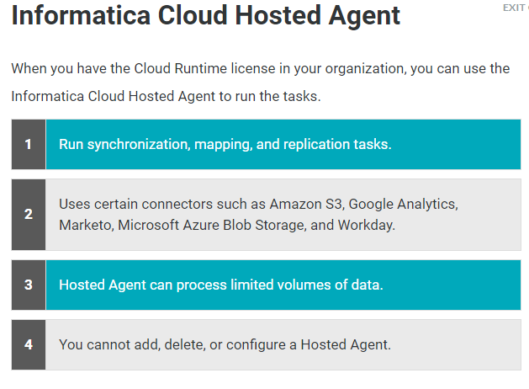
What is a Runtime Environment?
A runtime environment is the execution platform that runs a data integration or application integration task. To run tasks in your organization, you must have at least one runtime environment set-up in your organization
Informatica Cloud supports two runtime environments
Informatica Cloud Hosted Agent
Informatica Cloud Secure Agent

Slide 18
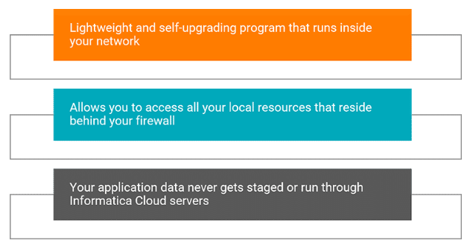
Informatica Cloud Secure Agent
The Secure Agent is a lightweight, self-upgrading program that runs on a machine inside your network.
It is responsible for moving data directly from the source to the target
You can access all your local resources, for example, databases or applications that reside behind the firewall through the secure agent
The Secure Agent is the local agent that is responsible for running the tasks in IICS. So, your application data never gets staged on the Informatica Cloud servers, keeping the data secure behind the firewall.

Slide 19
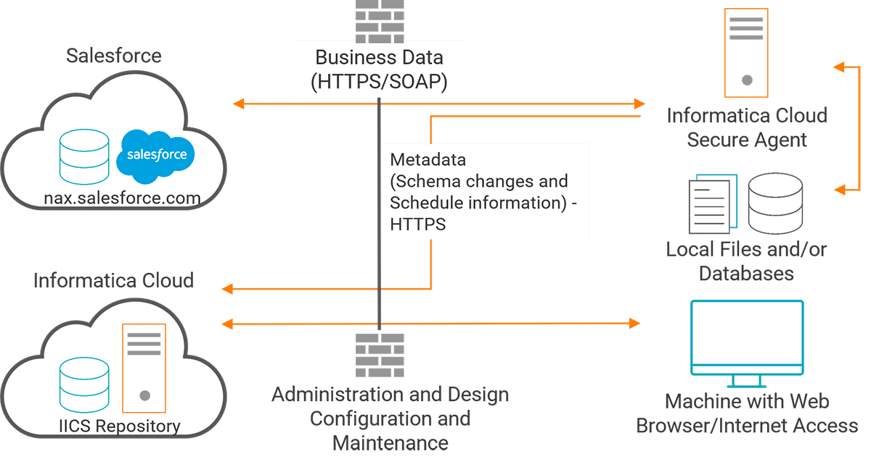
Secure Agent Architecture

Slide 20
What is CAI in IDMC?
CAI stands for Cloud Application Integration in Informatica Intelligent Data Management Cloud (IDMC).
It is used to integrate applications, APIs, events, and workflows — NOT for heavy ETL.
Typical CAI Use Cases
Application-to-Application (A2A)
  Salesforce ↔ SAP
  ServiceNow ↔ Oracle ERP
API Integrations
  Consume / expose REST & SOAP APIs
Event-driven processes
  File arrival triggers
  Business events
Workflow Orchestration
  If / else / decision-based flows
Microservice-style logic
  Lightweight transformations
Near real-time integration

Slide 21
What is CAI in IDMC?
CAI stands for Cloud Application Integration in Informatica Intelligent Data Management Cloud (IDMC).
It is used to integrate applications, APIs, events, and workflows — NOT for heavy ETL.
Why CAI? (Why not CDI?)
This answers “why CAI and why not CDI”
Why use CAI
  Designed for real-time & near real-time
  Strong API orchestration
  Excellent workflow control
  Supports event-driven architecture
  Ideal for business process automation

Slide 22
Why NOT CDI in CAI scenarios?
Requirement | CDI | CAI
API orchestration | No | Yes
Real-time processing | No | Yes
Workflow & decisions | Limited | Strong
Event-based triggers | Limited | Native
Application sync | Basic | Advanced
Why NOT CAI? (When CAI is not right)
Scenario | Why CAI not suitable
Heavy data transformation | Not designed for ETL
Large volumes (millions rows) | Performance & cost
Data warehousing loads | CDI / ELT better
SCD logic | CDI
Complex joins / aggregations | CDI
Notes:
API orchestration means coordinating and managing multiple APIs in a defined sequence to complete one business process.
Booking a flight online
Call User API → validate user
Call Payment API → collect money
Call Airline API → book seat
Call Notification API → send ticket

Slide 23
What is a Process in CAI?
A Process in CAI (Cloud Application Integration) is a visual, executable workflow that defines how a business or integration flow runs step-by-step in response to an event or API call.
Example: Customer Onboarding Process
  API receives new customer data
  Validate input
  Call CRM API → create customer
  Call ERP API → create account
  Trigger CDI → load data to warehouse
  Send confirmation email
Notes:
API orchestration means coordinating and managing multiple APIs in a defined sequence to complete one business process.
Booking a flight online
Call User API → validate user
Call Payment API → collect money
Call Airline API → book seat
Call Notification API → send ticket

Slide 24
What is an App Connector (Application Connector) in CAI?
In Informatica Intelligent Data Management Cloud (IDMC), an App Connector is a prebuilt, secure adapter that lets CAI (Cloud Application Integration) connect to applications and APIs without writing code.
Think of an app connector like a plug:
  You plug CAI into Salesforce / SAP / ServiceNow
  Authentication, endpoints, and formats are already handled
  You just configure and use actions
App connectors are used in CAI Processes to:
  Call SaaS applications
  Invoke REST / SOAP APIs
  Perform real-time app-to-app integration
  Orchestrate multiple systems in one flow
Notes:
API orchestration means coordinating and managing multiple APIs in a defined sequence to complete one business process.
Booking a flight online
Call User API → validate user
Call Payment API → collect money
Call Airline API → book seat
Call Notification API → send ticket

Slide 25
What is an App Connector (Application Connector) in CAI?
In Informatica Intelligent Data Management Cloud (IDMC), an App Connector is a prebuilt, secure adapter that lets CAI (Cloud Application Integration) connect to applications and APIs without writing code.
Think of an app connector like a plug:
  You plug CAI into Salesforce / SAP / ServiceNow
  Authentication, endpoints, and formats are already handled
  You just configure and use actions
App connectors are used in CAI Processes to:
  Call SaaS applications
  Invoke REST / SOAP APIs
  Perform real-time app-to-app integration
  Orchestrate multiple systems in one flow
Notes:
API orchestration means coordinating and managing multiple APIs in a defined sequence to complete one business process.
Booking a flight online
Call User API → validate user
Call Payment API → collect money
Call Airline API → book seat
Call Notification API → send ticket

Slide 26
What is a Service Connector in CAI?
A Service Connector is a generic connector used in CAI (Cloud Application Integration) to call external services/APIs—mainly REST and SOAP—when a prebuilt App Connector is not available.
Service Connector = Build your own API connection
Used in CAI Processes for:
  Calling custom REST APIs
  Consuming SOAP web services
  Integrating with in-house applications
  API orchestration across multiple systems
Notes:
API orchestration means coordinating and managing multiple APIs in a defined sequence to complete one business process.
Booking a flight online
Call User API → validate user
Call Payment API → collect money
Call Airline API → book seat
Call Notification API → send ticket

Slide 27
What are Process Objects in CAI?
In Informatica Intelligent Data Management Cloud (IDMC), Process Objects are custom data models used in CAI (Cloud Application Integration) to store, structure, and pass data between steps in a Process.
Process Objects = Data containers used inside CAI processes
Process Objects are used to:
  Capture input from APIs
  Hold responses from connectors
  Pass data between process steps
  Define request / response schemas
  Standardize data across integrations
Notes:
API orchestration means coordinating and managing multiple APIs in a defined sequence to complete one business process.
Booking a flight online
Call User API → validate user
Call Payment API → collect money
Call Airline API → book seat
Call Notification API → send ticket

